Slide 1
SPACE Xplorer
Lee Yu Xian 155118A
Sri Sham Haran 155129R
Teo Jia Hao 155209G
Jacob Yang Shen Ramal 153488J

Slide 2
Application Overview
You’ve just crash landed onto a lonesome planet, and you met a friendly alien.
You are to mine the minerals within the planet in order to repair your ship.
Secret weapons are hidden in the planet, and the alien will hint you about it.
The minerals ores are magical, which increase the ship’s ability and weapon’s damage
Help the alien get back to his home planet, but be careful, that’s where the fun begin!

Slide 3
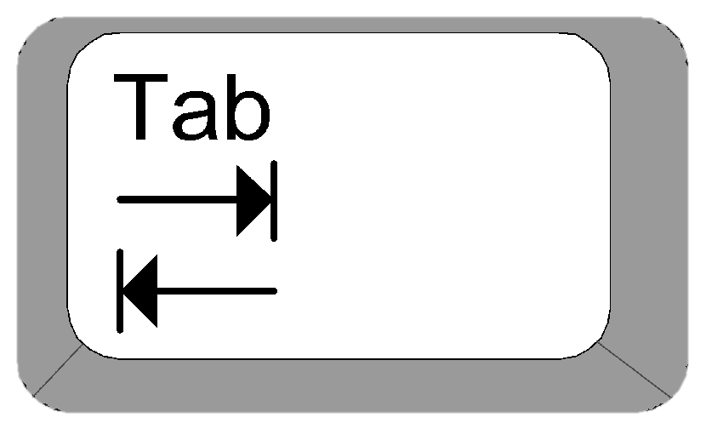
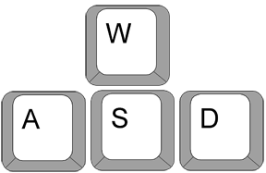

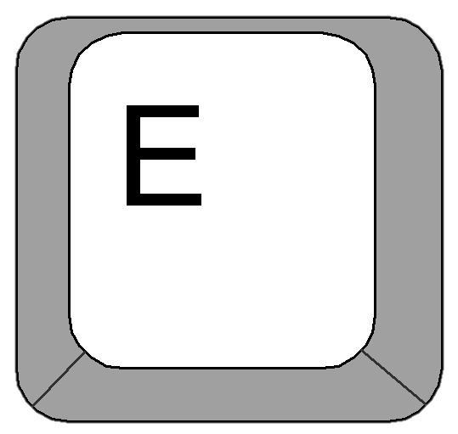
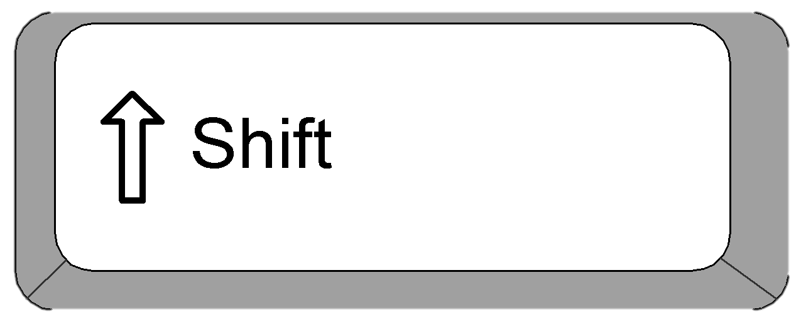





Instructions
Toggle Quest Tab
Interact
Movement
Rotate camera
Run
Jump
Use Sword/Punch
Use Gun
View Skills Level
Reset

Slide 4
Summary
Implementation | Quantity
Number of lights | 1
Type of lights | 1 ( Directional)
Number of camera | 2
Number of OBJs loaded | 21
Number of TGA loaded | 58

Slide 5
Activities & Interactions (Task list)
Lee Yu Xian, 155118A
Object & Hitbox
Weapons
Inventory system
Camera
Bullet
Sri Sham, 155129R
Boss battle
Terrain generations
Ores and Tree
Infinite land
Bullet
Teo Jia Hao, 155209G
Menus
Main Menu
Pause Menu
UI
NPC
Distance Checker
Jacob Yang Shen Ramal, 153488J
Ship Movement

Slide 6
NPC Behaviour

Slide 7
Scenario

Slide 8
Misc. Features
Upgrade system
Mining extra mineral ores will improve the ship’s handling and weapon damage
Storyline
Follow the storyline to further improve the game
One thing lead to another, the NPC takes the lead.
Secret hidden weapon
Find the gun. Have fun!
Chop down trees
Just for the fun of it.

Slide 9
Gantt Chart and UML

Slide 10
Thing we’ve learnt

Slide 11
Problems encountered, Best & Worst of SP2

